Slide 1
Regression Analysis
Model Selection
Nicoleta Serban, Ph.D.
Professor
Stewart School of Industrial and Systems Engineering
Regularized Regression:
Data Examples

Slide 2

About This Lesson

Slide 3
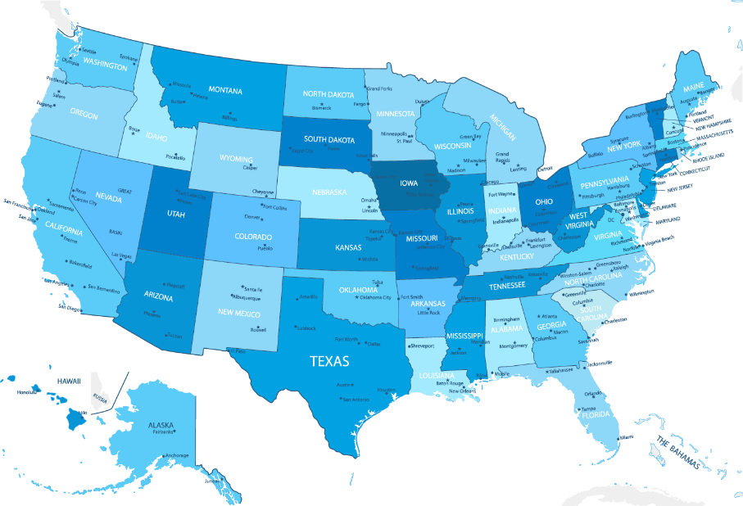
Ranking States by SAT Performance
Which variables are associated with state average SAT scores?
After accounting for selection biases, how do the states rank?
Which states perform best for the amount of money they spend?
SAT Mean Score by State – Year 1982
790 (South Carolina) – 1088 (Iowa)

Slide 4
Ridge Regression
library(MASS)
## Scale the predicting variables and the response variable
ltakers = log(takers)
predictors = cbind(ltakers, rank, income, years, public, expend)
predictors = scale(predictors)
sat.scaled = scale(sat)
## Apply ridge regression for a range of penalty constants
lambda = seq(0, 10, by=0.25)
out = lm.ridge(sat.scaled~predictors, lambda=lambda)
round(out$GCV, 5)
which(out$GCV == min(out$GCV))
2.25
10
round(out$coef[,10], 4)
predictorsltakers predictorsrank predictorsincome predictorsyears predictorspublic
-0.4771 0.4195 0.0223 0.1796 -0.0028
predictorsexpend
0.1808
The ridge regression outputs estimates for each lambda in the considered range (not shown)
The lambda is selected to minimize the (generalized) CV score

Slide 5
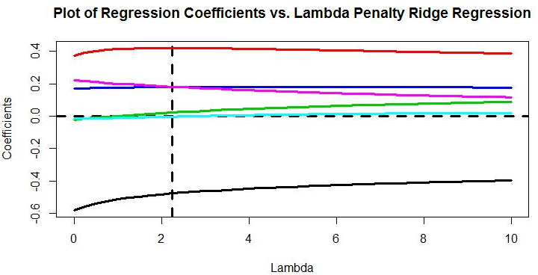
Ridge Regression
plot(lambda, out$coef[1,], type = "l", col=1, lwd=3,
xlab = "Lambda", ylab = "Coefficients",
main = "Plot of Regression Coefficients vs. Lambda Penalty Ridge Regression",
ylim = c(min(out$coef), max(out$coef)))
for(i in 2:6)
points(lambda, out$coef[i,], type = "l", col=i, lwd=3)
abline(h = 0, lty = 2, lwd = 3)
abline(v = 2.25, lty = 2, lwd=3)

Slide 6
LASSO Regression
library(lars)
object = lars(x=predictors, y=sat.scaled)
Object
Sequence of LASSO moves:
ltakers rank years expend income public
Var 1 2 4 6 3 5
Step 1 2 3 4 5 6
round(object$Cp,2)
0 1 2 3 4 5 6
349.91 103.40 46.89 35.64 3.10 5.09 7.00
The selected model according to Malow’s Cp is at the fourth variable introduced in the model.

Slide 7
LASSO Regression: First Implementation
library(lars)
object = lars(x=predictors, y=sat.scaled)
Object
Sequence of LASSO moves:
ltakers rank years expend income public
Var 1 2 4 6 3 5
Step 1 2 3 4 5 6
round(object$Cp,2)
0 1 2 3 4 5 6
349.91 103.40 46.89 35.64 3.10 5.09 7.00
The selected model according to Malow’s Cp is at the fourth variable introduced in the model.
From the order the predictors were added, i.e., log(takers), rank, years, expend, income and public, the first four are selected
After LASSO variable selection, apply ordinary least squares (OLS) with the selected predicting variables

Slide 8
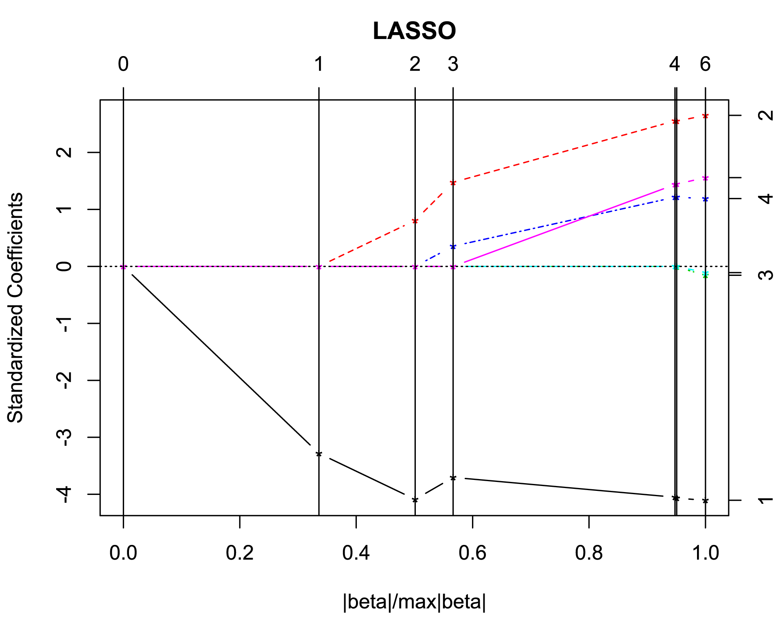
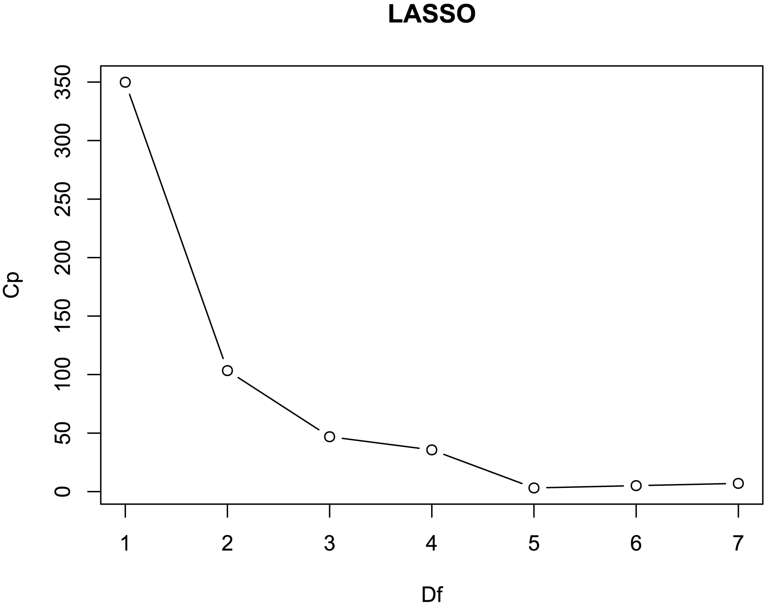
LASSO Regression: First Implementation
plot.lars(object)
plot.lars(object, xvar="df", plottype="Cp")

Slide 9
LASSO Regression: First Implementation
plot.lars(object)
plot.lars(object, xvar="df", plottype="Cp")
From the order the predictors were added, i.e., log(takers), rank, years, expend, income and public, the first four are selected

Slide 10
LASSO Regression: Second Implementation
library(glmnet) # alpha=1 lasso, alpha=0 ridge
Xpred= cbind(ltakers, rank, income, years, public, expend)
# Find the optimal lambda using 10-fold CV
satmodel.cv=cv.glmnet(Xpred, sat, alpha=1, nfolds=10)
## Fit lasso model with 100 values for lambda
satmodel = glmnet(Xpred, sat, alpha = 1, nlambda=100)
## Extract coefficients at optimal lambda
coef(satmodel, s=satmodel.cv$lambda.min)
Because CV uses random assignments, expect slightly different coefficients each time it is run.
(Intercept) | 516.519096
ltakers | -37.244873
rank | 3.420034
income | .
years | 13.780563
public | .
expend | 1.662338
Using LASSO and the penalty selected using 10-fold CV, the selected predictors are: log(takers), rank, years, and expend

Slide 11
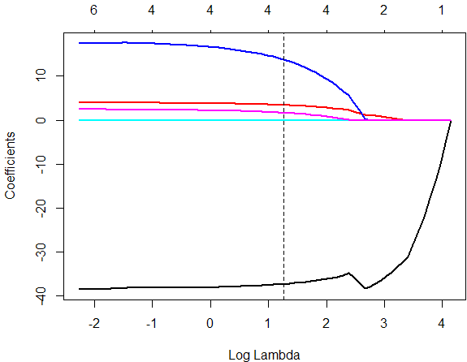
LASSO Regression: Second Implementation
## Plot coefficient paths
plot(satmodel,xvar="lambda", lwd=2)
abline(v=log(satmodel.cv$lambda.min), col='black', lty=2)

Slide 12
Elastic Net Regression
library(glmnet) # alpha=1 lasso, alpha=0 ridge
Xpred= cbind(ltakers, rank, income, years, public, expend)
# Find the optimal lambda using 10-fold CV
satmodel.cv=cv.glmnet(Xpred, sat, alpha=0.5, nfolds=10)
## Fit elastic net model with 100 values for lambda
satmodel = glmnet(Xpred, sat, alpha=0.5, nlambda = 100)
## Plot coefficient paths
coef(satmodel, s=satmodel.cv$lambda.min)
Because CV uses random assignments, expect slightly different coefficients each time it is run.
(Intercept) | 386.70798566
ltakers | -32.76143283
rank | 4.24246653
income | 0.01727723
years | 16.40041447
public | .
expend | 1.83649835
Using Elastic Net and the penalty selected using 10-fold CV, the selected predictors are: log(takers), rank, income, years, and expend

Slide 13
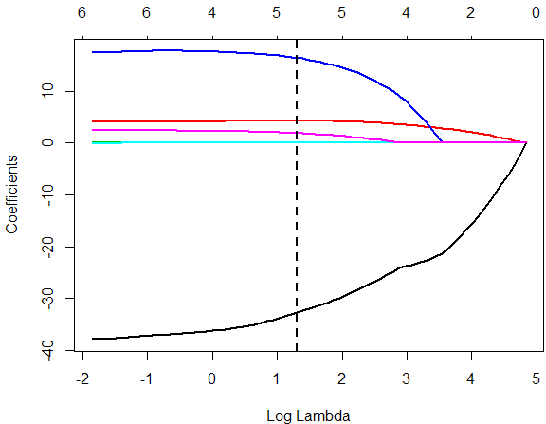
Elastic Net
## Extract coefficients at optimal lambda
plot(satmodel, xvar="lambda", lwd=2)
abline(v=log(satmodel.cv$lambda.min), col='black', lty=2, lwd=2)

Slide 14
Overview of All Selection Approaches
 | Log(Takers) | Rank | Income | Years | Public | Expend
Best Subset & Mallow’s Cp |  | × |  | × | × | ×
Stepwise & AIC | × | × |  | × |  | ×
LASSO & Mallow’s Cp | × | × |  | × |  | ×
Lasso & 10-fold CV | × | × |  | × |  | ×
Elastic Net & 10-fold CV | × | × | × | × |  | ×
Rank, Years, and Expend are selected by all approaches
Best Subset alone selects Public and does not select Takers
Income is selected only by Elastic Net

Slide 15
Predicting Bankruptcy
Effective bankruptcy prediction is useful for investors and analysts, allowing for accurate evaluation of a firm’s prospects.
Roughly 40 years ago, Ed Altman showed that publicly available financial indicators can be used to distinguish between firms that are about to go bankrupt and those that are not.
Which financial indicators are associated with bankruptcy for telecommunications firms?
Acknowledgement: This example was provided by Dr. Jeffrey Simonoff from New York University and was inspired by the honors thesis of Jeffrey Lui.

Slide 16
LASSO Regression
library(glmnet)
X = cbind(WC.TA, RE.TA, EBIT.TA, S.TA, BVE.BVL)
## 10-fold CV to find the optimal lambda
bank5.cv = cv.glmnet(X, Bankrupt, family=c("binomial"), alpha=1, type="class", nfolds=10)
## Fit lasso model with 100 values for lambda
bank5 = glmnet(X, Bankrupt, family=c("binomial"), alpha=1, nlambda=100)
## Extract coefficients at optimal lambda
coef(bank5, s=bank5.cv$lambda.min)
(Intercept) | -0.95995368
WC.TA | .
RE.TA | -0.02874387
EBIT.TA | -0.05757731
S.TA | .
BVE.BVL | -0.14135425
Using LASSO and the penalty selected using 10-fold CV, the selected predictors are: RE.TA, EBIT.TA, and BE.BVL

Slide 17
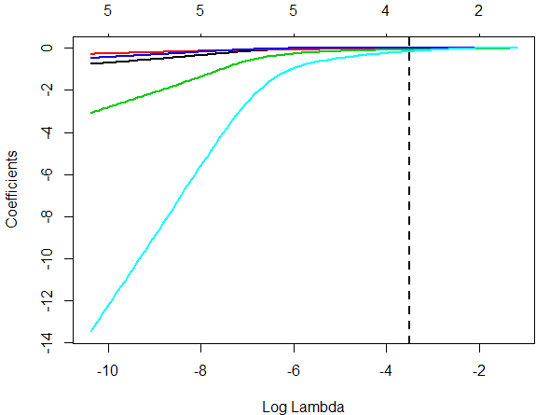
LASSO Regression
## Plot coefficient paths
plot(bank5, xvar="lambda", lwd=2)
abline(v=log(bank5.cv$lambda.min), col='black', lty 2, lwd=2)

Slide 18
Elastic Net Regression
library(glmnet) # alpha=1 lasso, alpha=0 ridge
X = cbind(WC.TA,RE.TA,EBIT.TA,S.TA,BVE.BVL)
## 10-fold CV to find the optimal lambda
bank6.cv = cv.glmnet(X, Bankrupt, family=c("binomial"), alpha= 0.5, type="class", nfolds=10)
## Fit elastic net model with 100 values for lambda
bank6 = glmnet(X, Bankrupt, family=c("binomial"), alpha=0.5, nlambda=100)
## Extract coefficients at optimal lambda
coef(bank6, s=bank6.cv$lambda.min)
(Intercept) | -0.572208580
WC.TA | -0.006693551
RE.TA | -0.015677213
EBIT.TA | -0.050962740
S.TA | .
BVE.BVL | -0.108940580
Using Elastic Net and the penalty selected using 10-fold CV, the selected predictors are: WC.TA, RE.TA, EBIT.TA, and BVE.BVL

Slide 19
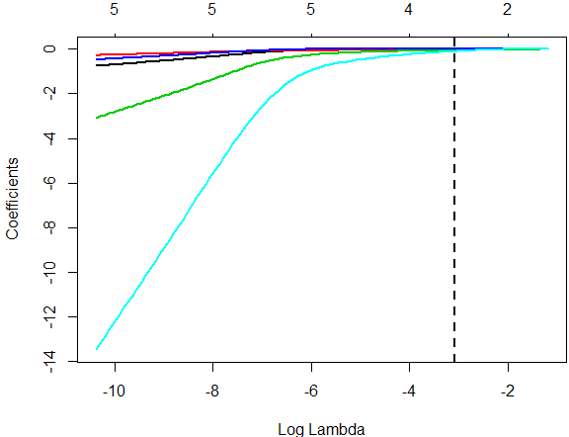
Elastic Net
## Plot coefficient paths
plot(bank5, xvar="lambda", lwd=2)
abline(v=log(bank6.cv$lambda.min), col='black', lty=2, lwd=2)

Slide 20
Overview of All Selection Approaches
 | WC.TA | RE.TA | EBIT.TA | S.TA | BVE.BVL
Best subset AIC |  | × | × |  | ×
Stepwise & AIC |  | × | × |  | ×
Lasso & 10-fold CV |  | × | × |  | ×
Elastic Net & 10-fold CV | × | × | × |  | ×

Slide 21

Summary

